Slide 1

Actionable Insights for Enhanced Public Safety (2021–Present)
NYC Motor Vehicle Collision Analysis
Prepared by: Ralish Routray
July 2025

Slide 2

Executive Summary
PURPOSE
To analyze city-wide collision data to identify high-risk zones, times, and actionable trends for improving officer deployment and public safety.
KEY FINDINGS
Collisions peak during afternoon rush hours (2-6 PM), with Brooklyn experiencing the highest volume. Key crash locations align with existing Vision Zero priority areas.
PROJECT IMPACT
This analysis provides a data-driven foundation to optimize patrol strategies, reduce fatalities and injuries, and enhance resource allocation for the department.

Slide 3



The Big Picture: City-Wide Collision Data Key Performance Indicators from ~414K records (2021–Present)
This infographic visualizes police-reported motor vehicle collisions in NYC where someone was injured, killed, or at least $1000 worth of damage occurred. The data is filtered for incidents from January 1, 2021, to the present day.

Slide 4

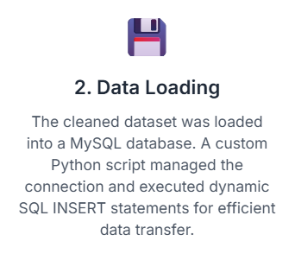
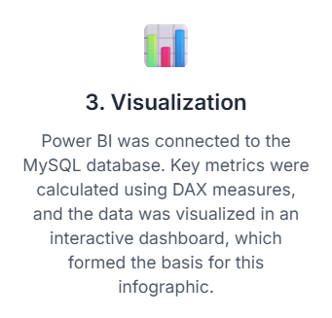
Project Workflow: From Raw Data to Insight

Slide 5

Tools & Technologies
• Python: Data cleaning and transformation
• MySQL: Structured data storage
• Power BI: Interactive data visualizations

Slide 6
ABOUT THE DATA
Dataset:
Motor Vehicle Collisions – Crashes
Provider:
NYC Open Data
Source Agency:
NYPD (MV-104AN reports)
Records Analyzed:
From 2.19M records, 414K relevant collisions from 2021–Present were analyzed.

Slide 7
Data Cleaning (Python)
• Selected relevant columns
• Removed rows with missing latitude/longitude
• Converted crash date/time formats
• Extracted Hour, Year, Month
• Final cleaned rows: ~414K (2021–2025)

Slide 8
Data Loading (MySQL)
• Created collisions table in MySQL (cleaned_nyc_collisions.sql)
• Used mysql.connector to load data from Python
• Used INSERT IGNORE for deduplication
• Table: nyc_crashes.collisions

Slide 9
Power BI Dashboard Overview
Connected Power BI to MySQL
Built KPIs: Total Collisions, Injuries, Fatalities
Filters: Borough, Year, Month, Hour
Tools: DAX, Slicers, Drilldowns

Slide 10
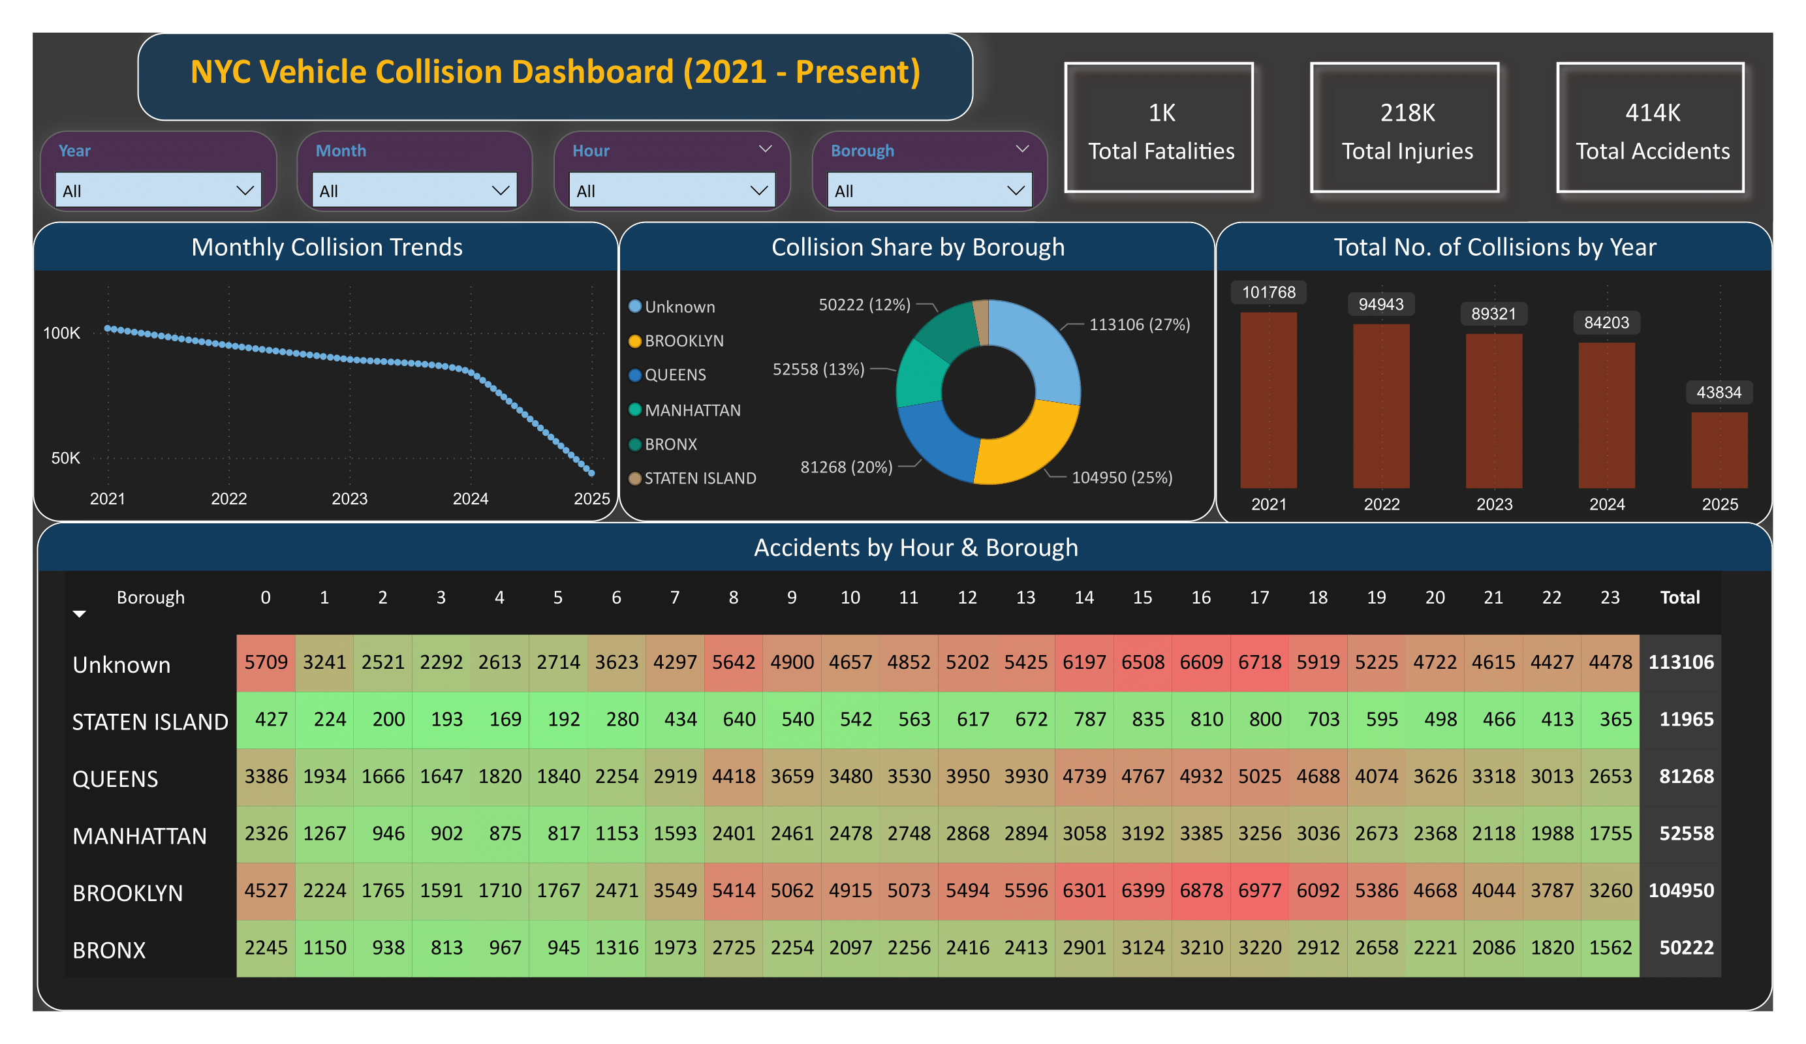

Slide 11
Key Visuals
KPI Cards
414K collisions, 218K injuries, 1K fatalities
Bar Chart
Collisions by Borough
Line Chart
Monthly Trends
Heatmap Table
Hour vs Borough
Donut Chart
Borough Distribution
Stacked Column Chart
Accidents by Year

Slide 12
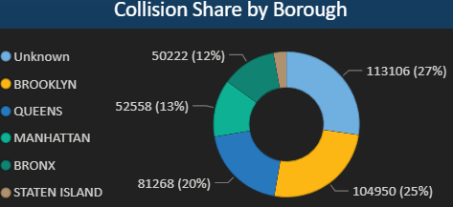
Collision Hotspots: A Borough Breakdown
While collisions occur city-wide, the distribution is not even. Brooklyn and Manhattan account for over half of all incidents, highlighting them as areas requiring significant attention for traffic safety initiatives.

Slide 13
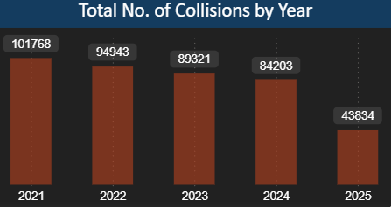
Year-Over-Year Collision Totals
There has been a consistent downward trend in the total number of collisions from 2021 through 2024. The data for 2025 represents a partial year and is expected to rise. This decline may reflect the impact of city-wide safety programs like Vision Zero.

Slide 14
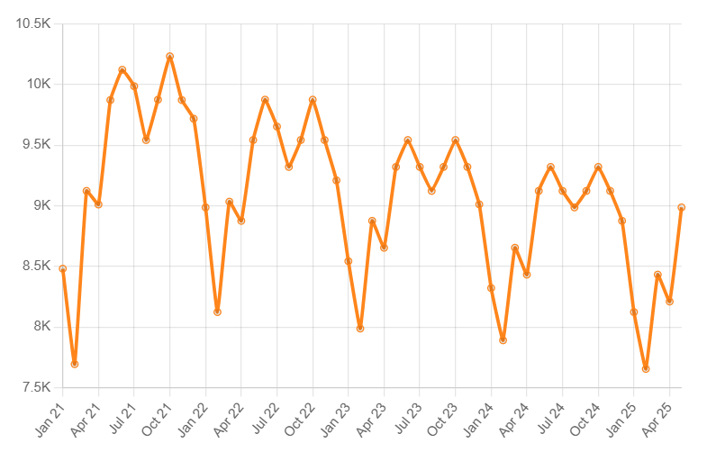
MONTHLY COLLISION TRENDS
This chart illustrates the collision count over the months from 2021 to the present. A clear and sharp decline is visible, showing a significant reduction in incidents over time, though seasonal patterns may still be present within each year.

Slide 15
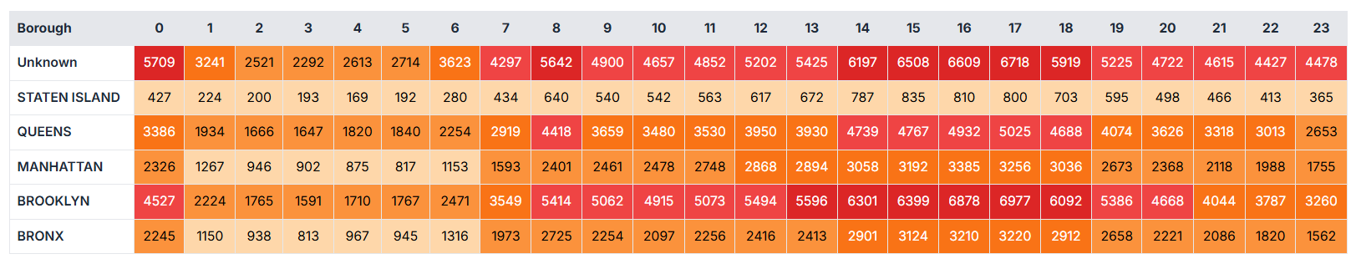
Accidents by Hour and Borough
Peak collision times vary by borough. Across the city, the afternoon and evening rush hours (3 PM to 6 PM) consistently show the highest number of incidents. Brooklyn sees a significant surge during these hours.

Slide 16
Key Insights & Recommendations for NYPD
Insight 1: Consistent Decline in Collisions
The overall number of collisions has shown a consistent downward trend from 2021 to 2024. This suggests that existing traffic safety initiatives, such as Vision Zero, may be having a positive impact.
Recommendation:
Sustain & Evaluate: Continue current safety programs and conduct in-depth evaluations to identify the most effective components for replication and enhancement.
Public Awareness: Leverage this positive trend in public awareness campaigns to reinforce safe driving behaviors and encourage community participation.

Slide 17
Key Insights & Recommendations for NYPD
Insight 2: Borough-Specific Hotspots
Manhattan and Brooklyn consistently account for the largest share of collisions. This indicates that these boroughs are critical areas for focused intervention.
Recommendation:
Targeted Enforcement: Increase police presence and enforcement of traffic laws in high-collision areas within Manhattan and Brooklyn, particularly during peak hours.
Infrastructure Review: Collaborate with DOT to review and improve road infrastructure, signage, and pedestrian crossings in these high-risk zones.

Slide 18
Key Insights & Recommendations for NYPD
Insight 3: Peak Collision Hours
The heatmap reveals that afternoon and evening rush hours (3 PM to 6 PM) are consistently the busiest for collisions across most boroughs, with Brooklyn showing a particularly significant surge during these times.
Recommendation:
Shift Patrols: Optimize patrol schedules to increase visibility and response times during peak collision hours.
Dynamic Messaging: Utilize dynamic message signs and public service announcements to warn drivers and pedestrians about increased risks during these specific hours.

Slide 19
Key Insights & Recommendations for NYPD
Insight 4: Data-Driven Resource Allocation
The detailed breakdown by hour, month, and borough provides granular data that can be used to allocate resources more effectively.
Recommendation:
Strategic Deployment: Deploy traffic enforcement units and emergency services based on historical patterns of collisions, focusing on times and locations with the highest incident rates.
Proactive Planning: Use these insights for proactive planning of traffic management strategies, especially during events or periods known to increase traffic volume.

Slide 20

Thank You
ContacT: ralishroutray@gmail.com

